Slide 1


VENDING MACHINE
ECE DEPARTMENT

Slide 2

TEAM MEMBERS
Sana Sayeeda (BU21EECE0100268)
Ramireddy Indumathi
(BU21EECE0100360)
Sinchana R (BU22EECE0100441)
T. Karthik
(BU21EECE0100164)
Athukuri V S Sai Jayanth
(BU21EECE0100310)

Slide 3

Challenges Of Vending Machine
Maintenance and Servicing
Security Concerns
Stock Management
Customer Service
Location and Accessibility
Energy Consumption
Technological Advancements
Regulatory Compliance
Environmental Impact

Slide 4

How To Overcome Challenges
Maintenance and Servicing
Routine Inspections: Implement regular maintenance schedules to ensure machines are clean and functioning correctly.
Remote Monitoring: Utilize IoT technology to monitor the status of vending machines remotely, allowing for proactive maintenance and quick response to issues.
Service Contracts: Establish service agreements with reliable technicians to ensure prompt repair services.

Slide 5
Environmental Impact
Sustainable Practices: Adopt sustainable practices such as using recyclable packaging, reducing waste, and implementing eco-friendly materials.
Waste Management Programs: Partner with recycling programs to manage waste responsibly.
Energy Efficiency: Continuously seek ways to improve the energy efficiency of machines and operations.
Location and Accessibility
Market Research: Conduct thorough market research to identify high-traffic, secure locations for placing vending machines.
Accessibility Compliance: Ensure machines are accessible to people with disabilities by adhering to relevant guidelines and incorporating features such as lower dispensing units and voice instructions.

Slide 6

Advantages of vending machine using fpga
Customization and Flexibility
Performance Enhancement
Energy Efficiency
Reliability and Durability
Security Features
Cost-Effectiveness
Advanced Features Integration
High-Resolution Displays and Interfaces
Scalability

Slide 7
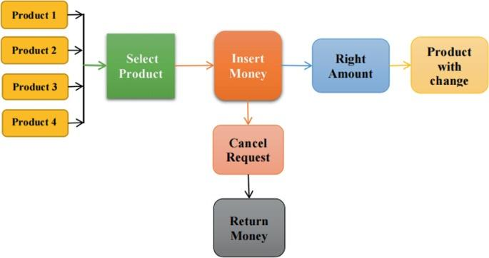
Flowchart Of Fpga Based Vending Machine

